Slide 1
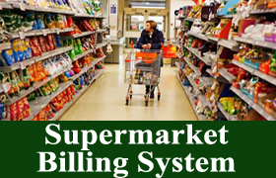
By
Ruchitha Padigapati(46281236)
Vara Lakshmi(46282339)
Surekha Kachana(46281313)
Lavanya Koyya(46282340)
Kalpana Challagundla(46282338)

Slide 2
CONTENT
Introduction
Requirements
Problem Statements
Functional Requirements
Technical Specifications
Flow chart
System Use-Case Diagram
System Sequence Diagram
Modules
Benefits
Conclusion

Slide 3

INTRODUCTION
The supermarket billing system is built to help supermarket calculate and display bills and serve the customer in a faster and efficient manner.
This system is built for fast data processing and bill generation for supermarket customers.
The billing database is a vast collection of product name, price and other product specific data.
This software project consists of an effective and easy to help the employee in easy bill calculation and providing an efficient customer service.

Slide 4
REQUIRMENTS
Problem Statement.
Functional Specifications.
Technical Specifications.

Slide 5
PROBLEM STATEMENT
This project is designed to assist supermarkets in calculating and displaying bills, as well as serving customers more quickly and efficiently.
Supermarket Billing System has product class with data members like product id, product name, product price, product discount.
Admin can add, modify, display, search, delete product record.
We have developed it using C++.It will also reduce the paperwork and reduce the time.

Slide 6
FUNCTIONAL REQUIRMENTS
• All records are saved in a file.
• Key features of the system are:
MAIN MENU
ADMIN MENU
ADD A PRODUCT
DELETE A PRODUCT
MODIFY A PRODUCT
SEARCH A PRODUCT
DISPLAY A PRODUCT
CUSTOMER MENU
CUSTOMER CHECK PRODUCT DETAILS
PLACE ORDER

Slide 7

TECHNICAL SPECIFICATION
Hear we are using the file for storing the data.
• Data Validation is implemented for username, password, product Id.
• Write optimized logic for searching as time complexity should not get increased while
searching any information.
• For this we can store all the data in a file.

Slide 8
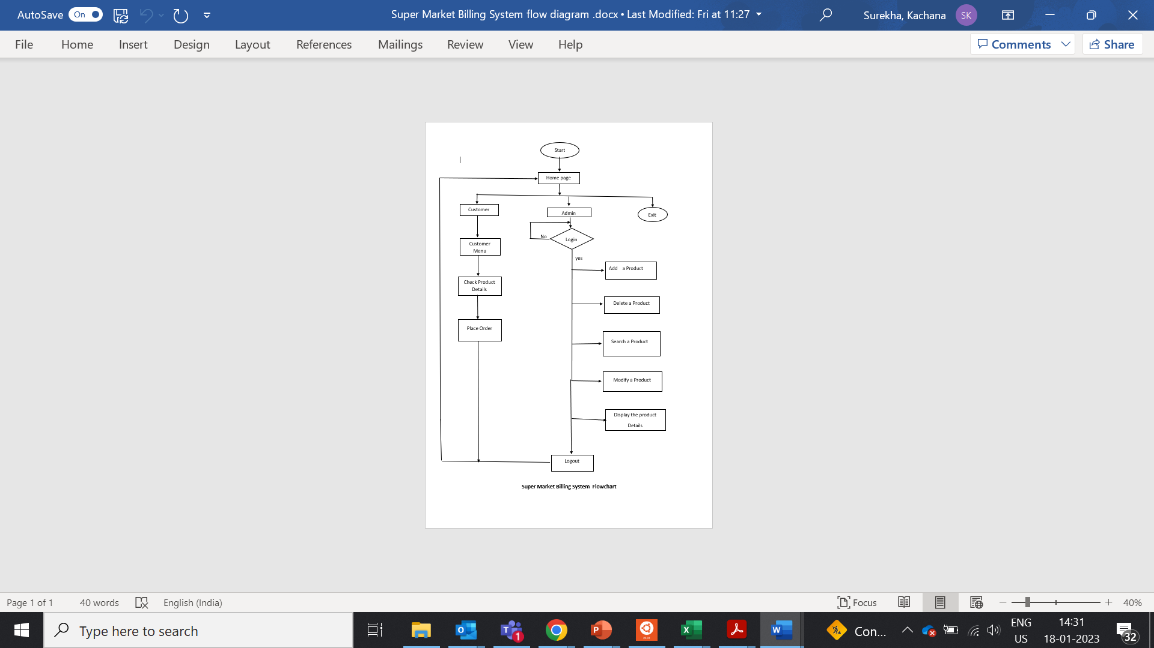
FLOWCHART

Slide 9
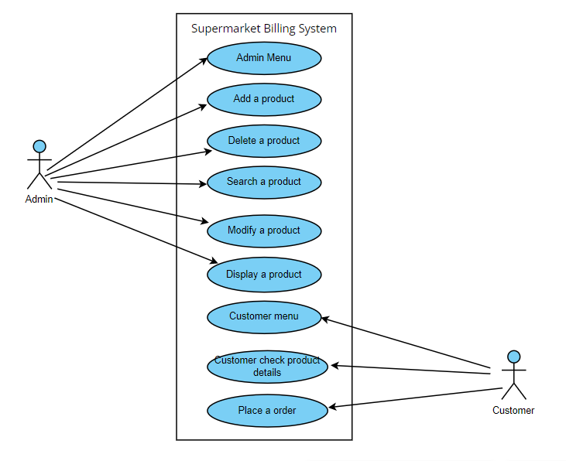
SYSTEM USE-CASE DIAGRAM

Slide 10
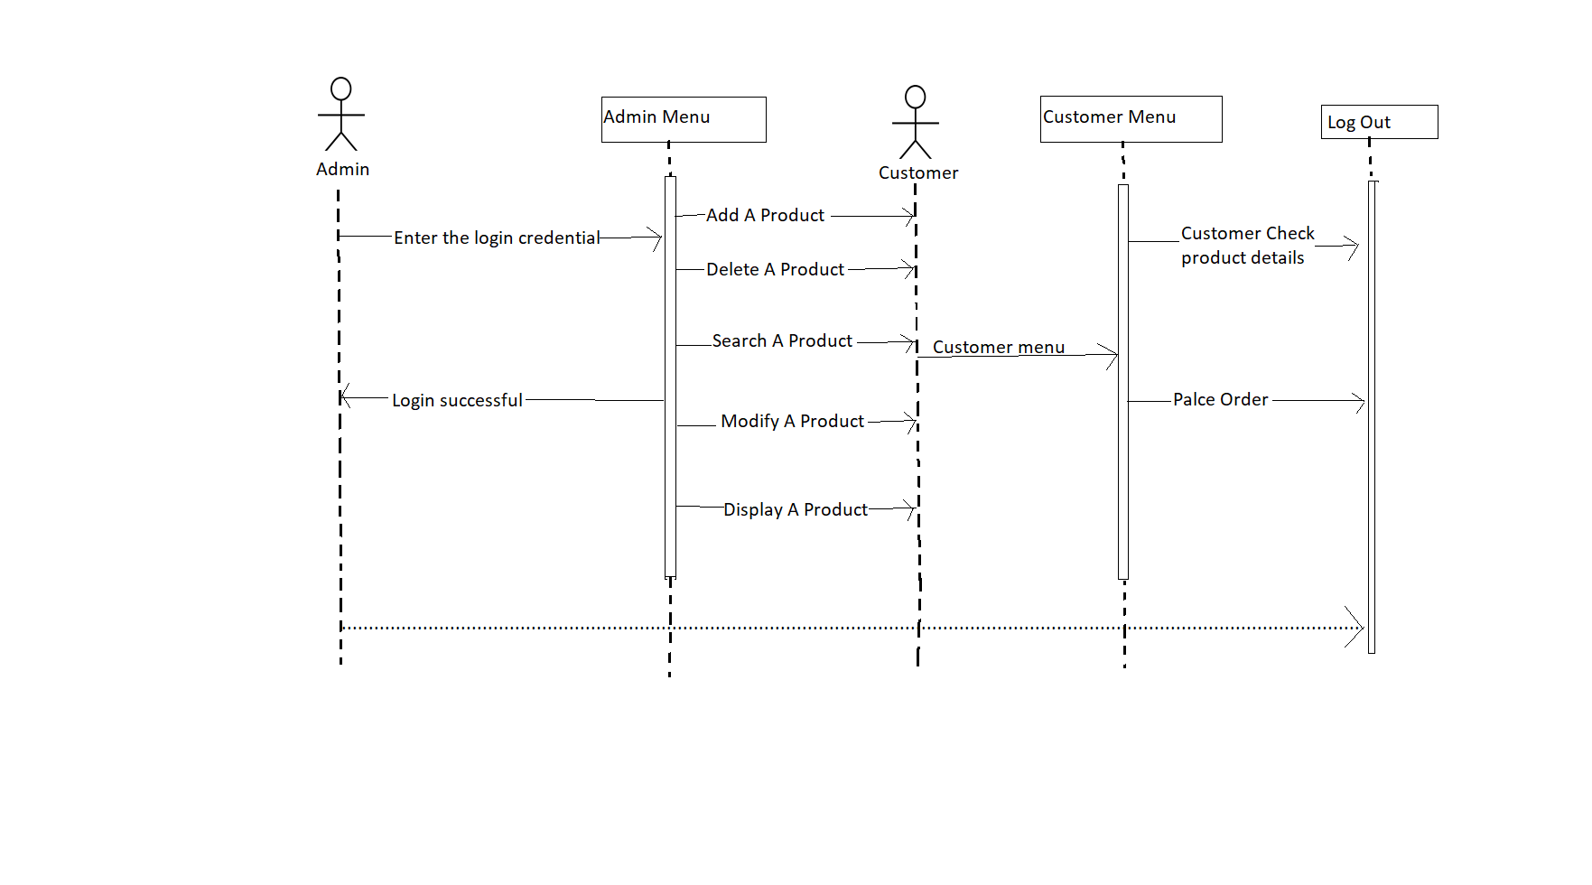
SYSTEM SEQUENCE DIAGRAM

Slide 11
MODULES
Admin Module
Customer Module
Data Validation Module

Slide 12

ADMIN MODULE
ADMIN LOGIN: Admin can login through login credentials and after successful login it display admin menu. If the login credentials are wrong, then relog in.
Displays the admin menu
ADMIN MENU:Admin can add new products, delete products, modify products, search product, display product.

Slide 13
CUSTOMER MODULE
Customer can check the product details and place order.
CUSTOMER CHECK PRODUCT DETAILS: Customer can see the product details like product name, product quantity, product id, product price, product discount.
PLACE ORDER: Customer can place the order as per customer need.

Slide 14
DATA VALIDATION MODULE
Data validation is the process of verifying and validating data that is collected before it is used.
Any type of data handling task, whether it is gathering data, analysing it, or structuring it for presentation, must include data validation to ensure accurate results.
In the proposed system, data validation is done for username, password, Product Code.

Slide 15
TECHNOLOGIES USED
System C ++
File Handling
Linux

Slide 16
BENEFITS
Saving in labor due to self-service system.
Supermarket has large turnover.
Low cast of operation.
Freedom of selection.
Shopping is very easy and quick.

Slide 17
TOOLS USED
GCC
MAKEFILE
VIM EDITIOR
VALIGRIND
SPLINT

Slide 18
CONCLUSION
Super Market Billing System has to do with making appropriate effort to stop the rising problem to all manual supermarket operation in order to enhance the operations of such supermarket.
The “supermarket Billing system” process made computerized to reduce human efforts & to increase the efficiency.
Our main aim of the project is to get the correct bills and maintains data of the supermarket.

Slide 19

THANK YOU

